Slide 1

Global institute of technology
Department of computer science and engineering
An industrial training
on
FRONTEND WEB DEVELOPMENT
Session:2022-23
Presented by: Prachi Singh
Roll No: 22EGJCS157
5th Semester
3rd year
submitted to:
Mr. Pradeep Jha
Head of department:
CS\IT\AI&DS

Slide 2

What is Web Development?
Web development refers to creating , maintaining and building the websites . It includes web publishing ,web design , web programming , and database management . It is the creation of an application that works over the internet i. e. websites .
2

Slide 3
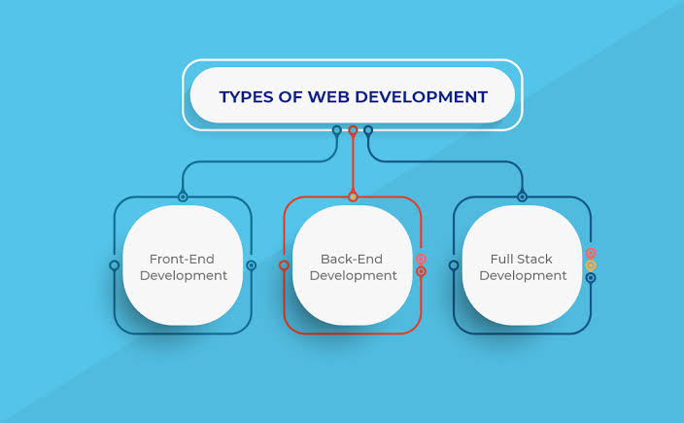
Types of Web development
3

Slide 4
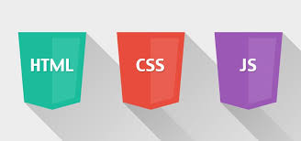
What is Frontend Development?
The part of a website where the user interacts directly is termed as front end . It is also referred to as the ‘client side’ of the application.
4

Slide 5

Introduction to HTML
HTML stands for Hyper Text Markup Language.
A Markup language is a set of markup tags.
With the help of HTML we can create our own web site.
HTML is not case sensitive language.
To save the HTML file with .html extension.
HTML documents contain HTML tags and plain text.
A tag is always enclosed in angle bracket <> like <HTML> and it comes in pairs like <HTML> and </HTML> i.e.
Start tag=<HTML>
End tag=</HTML>
5

Slide 6
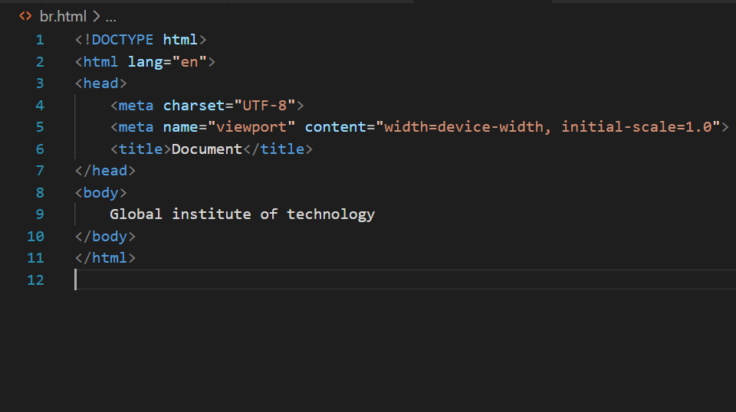
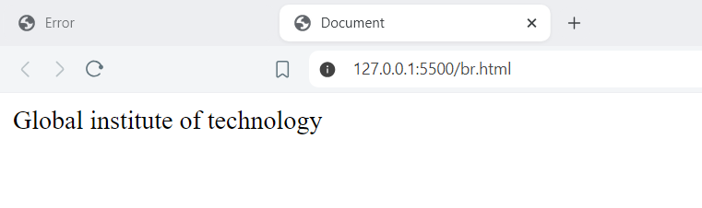
HTML Code with output
6

Slide 7
HTML Tags
<!Doctype HTML> Declares the HTML version.
<html> Wraps the entire HTML document.
<head> contains metadata like title , character set , styles , and scripts.
<title> sets the document title.
<body> contains the main content of the html document.
<h1 to h6> Defines headings , where <h1> is the largest and <h6> is smallest.
<p> Represents paragraphs of text.
<a> Creates hyperlinks , linking to another document or resource.
<img> Embeds images.
<ul> and<ol> Define unordered and ordered lists.
<li> Represents list items within <ul> or <ol>.
<div> Groups content for styling or layout purposes.
<span> Applies styles to inline elements.
<br> Inserts a line break within text.

Slide 8
<hr> Represents a horizontal rule or line.
<input> Creates input fields for forms.
<form> Wraps from elements for user input.
<table>,<tr>, .<td>, <th> Constructs tables , rows, and cells for tabular data.
<iframe> Embeds external content , like webpage or video , within the current document
<article> Represents a self-contained piece of content that could be distributed.
<aside> Defines content aside from the page content , often used for sidebars.
<footer> Represents the footer section or page.
<header> Represents the header of a section or page.
<Nav> Defines a navigation menu.
<section> Represents a generic section of content.
<main> Wraps the main content of the document , excluding headers , footers and sidebars.
<label> Describe an <input> element.
<caption> Table caption.
<video> Embeds video.

Slide 9

Introduction to CSS?
CSS stands for Cascading style sheets.
Markup language used in the web document.
Various elements like text , font and colour are used in CSS.
Can be used to bring styles in the web documents.
Each declaration in css consists of a property and a value.

Slide 10
Basic Syntax of CSS
Selector{
Property : value;
Property : value;
…….
Property : value;
}
code:
P{
Colour: red;
Text-align : none;
Margin:5px;
}

Slide 11
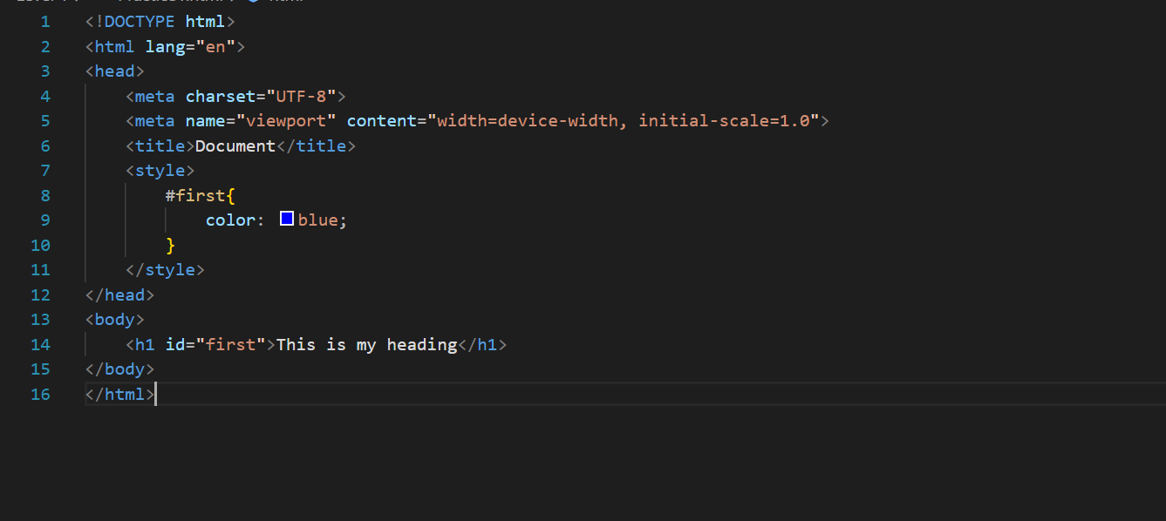
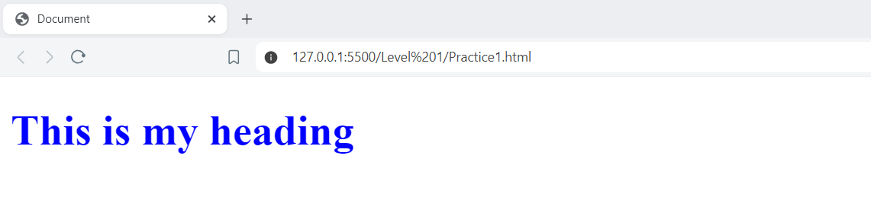
CSS code with output

Slide 12
Thank you
-Prachi Singh
Prachisingh.as1902@gmail.com
12

